Slide 1
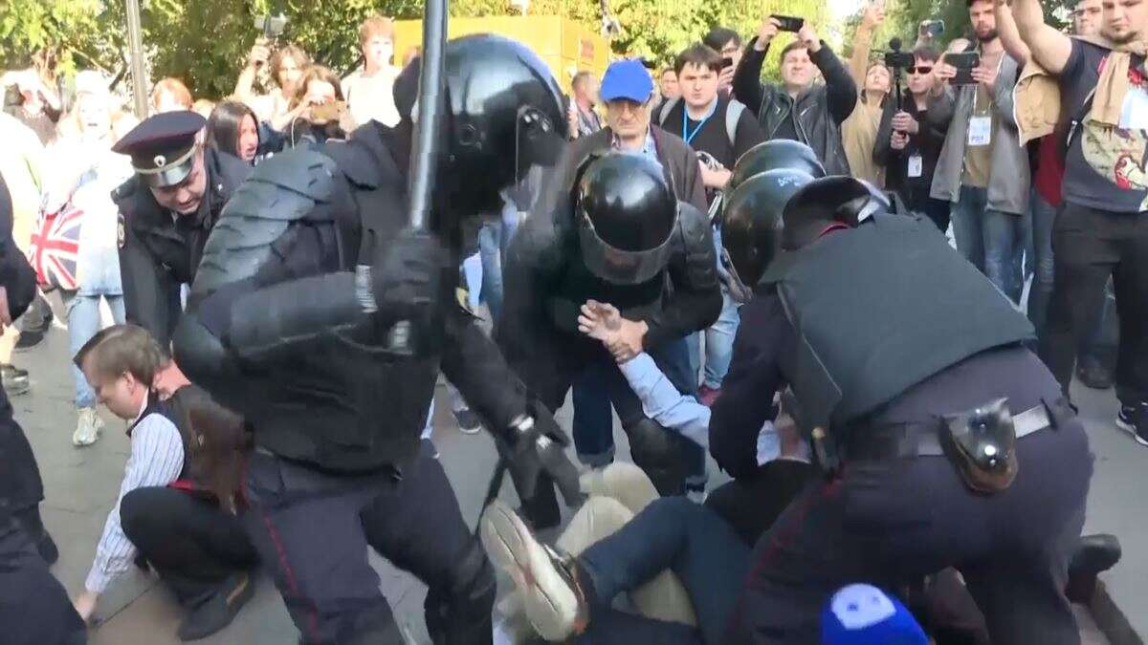
The Impact Of Police Brutality On The Lives Of African American Citizens
Name
Institution

Slide 2

Agendas
Abstract;
Abbreviated Literature Review;
Issue(s);
Critical Analysis;
Conclusion;
Policy Implications;
Suggestions for Future Research; and
References in APA format.

Slide 3
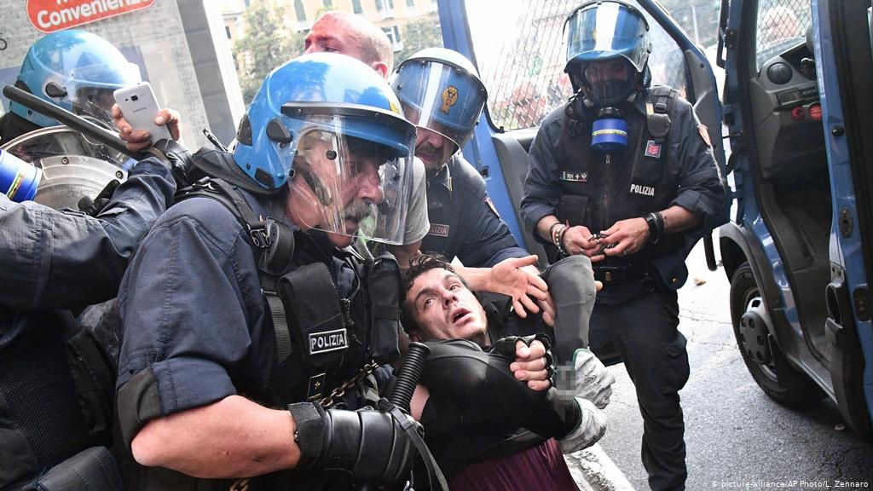
1. Abstract
Police brutality, also known as police violence is a term used to refer to the use of excessive force against an individual thus violating the rights of an individual.
Police brutality can take the form of physical or verbal harassment, physical or mental injury, property damage, and even death.
In the past, people of color (African-Americans) have raised the alarm over the targeted police brutality, which is part of a more extensive systemic racial discrimination (Chaney, Cassandra, and Ray V. Robertson).
This paper seeks to investigate the impact of police brutality on the lives of African-American. This paper addresses how police brutality affects the lives of African American citizens socially, economically, psychologically and mentally.

Slide 4
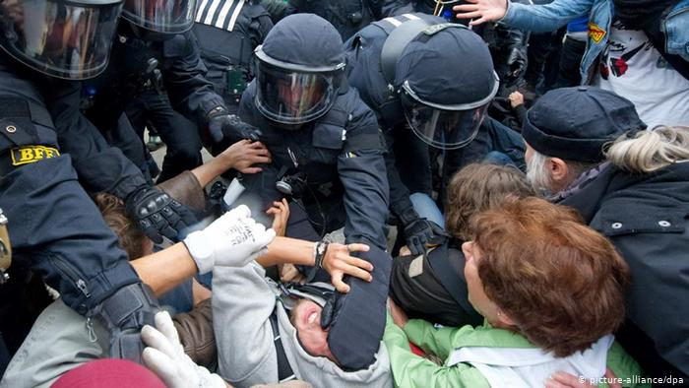
2. Literature Review
According to Chaney, Cassandra, and Ray, (2013) some American neighborhoods are heavily policed while others are perfectly peaceful with little police presence.
In some of the heavily policed neighborhoods, most of the teenage African Americans have had unpleasant experience with law enforcers.
There is a notion that most of the people in such neighborhoods are criminal elements and the innocent ones adopt criminal tendencies by association.
Police officers in such areas conduct body searches for almost all the residents. These body searches are so frequent that African American teenagers already have the notion that the law is made to keep them in check.
It is normal that teenagers have a feeling of defiance and are eager to try new things they have not experienced before.
As such, police officers uses brutality to control teenage African Americans and direct them away from crime by teaching them a lesson (Chaney, Cassandra, and Ray, 2013)

Slide 5
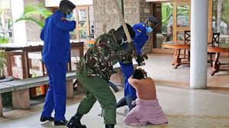
2. Literature Review Cont’d
Also, as Hutto, Jonathan and Rodney claim, Police brutality brings about shame and degradation to African Americans. For instance, a father takes his daughter shopping in a supermarket.
Outside the supermarket, two police officers are looking suspiciously at the father. The father and his daughter enter the supermarket for shopping unaware that one of the police officers had followed them inside the supermarket and that he was trailing them at a distance.
When they are done shopping, they approach the counter to pay for the goods. As the father lifts his long t-shirt to retrieve the wallet from his back pocket, the police officer orders him, “Don’t move. Drop your weapon and put your hands on the head.” He is then ordered to lay on the ground as the second police officer intervenes and conducts a body search (Hutto, Jonathan & Green, 2016).
The other officer has his gun pointed at the father, who lay on the ground, scared and shaking. The daughter is crying next to the counter, pleading with the officers not to hurt her father. After a body search, the officer finds no weapon retrieving a wallet from his back pocket. All the while, a crowd of people has gathered around to witness the unfolding spectacle. The officers disperse the crowd and offer a brief apology to the man who gets up and hugs her crying and terrified daughter.

Slide 6
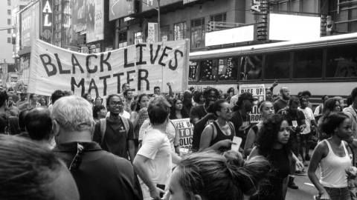
3. Issues
Sociological Issue
Police brutality has caused the loss of African American lives.
A police officer was recently filmed kneeling on the neck of a suspected criminal until he lost his life.
It later emerged that George Floyd (the suspected criminal) was innocent, but he had lost his life because of police brutality.
For long, police officers have been condemned for the excessive use of force that, at times, causes the loss of lives.
These claims have always fallen on deaf ears, and no action is taken to end the police killing of African American people
Killing African American citizens as a result of brutality brings about loss and grief to the bereaved families.
Many mothers have had to grief and burry their sons as a result of police brutality. Fathers, brothers, sisters, relatives, and even friends have had to contend with the death of their loved ones because of police brutality.

Slide 7
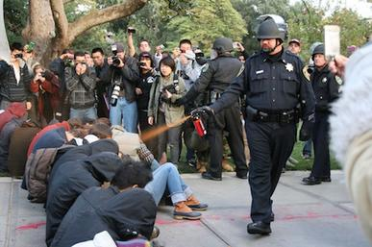
4. Critical Analysis
Police brutality can take the form of physical force applied which affects the health of African American when police officers use excessive force when dealing with suspected criminals.
Police Brutality includes the use of pepper spray when the suspect has already surrendered, beating up a suspected criminal after arresting them, among other acts of brutality against African American citizens (Alang, Sirry, et al).
The health impact of police brutality is not limited to physical force but also psychological torture causing anxiety.
Police brutality affects how African Americans interact with other people in society.
Police brutality affects parenting process among African American citizens (Rodríguez, Dylan). Children are brought up knowing the difference between right and wrong, and at a certain age, they are made aware of their rights.
Finally, police brutality on the African American citizens speaks volumes about the systematic racial discrimination in the united states of America.

Slide 8
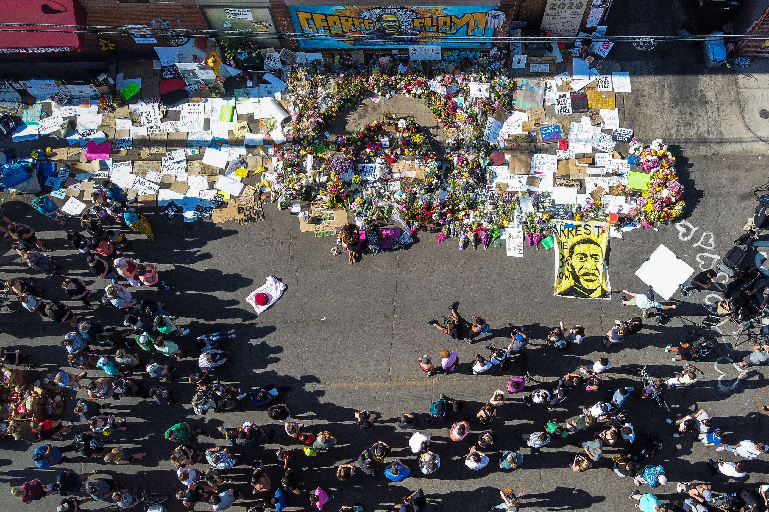
5. Conclusion
Police brutality is a social evil that should not be encouraged or tolerated at any cost. This is because it spreads division, which tends to rapture the social fabric.
It takes more resources to repair a torn social fabric than it takes to tear it apart. Police brutality raises the issue of discrimination against African American citizens, which has been going on for centuries.
America is better than it was in slavery, and it is not regarded as the land of the free for no reason. Police brutality targeted on the African American citizens goes against this definition of this great country, putting it in the spotlight for bad reasons.
In a truly democratic and free country, every citizen's rights are respected and upheld, but police brutality has violated the rights of so many African American citizens.
The paper concludes that police brutality affects the social, health, and economic activities in the lives of African American citizens.

Slide 9
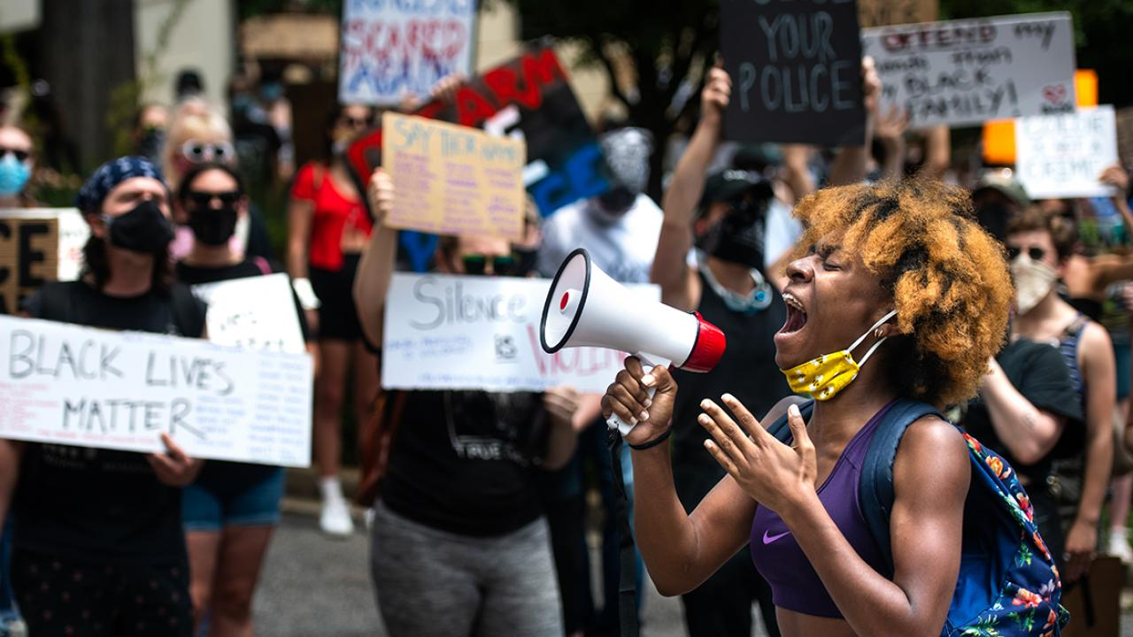
6. Policy Implications
Police brutality is affecting the family roles by hospitalizing, injuring, and even maiming members of a family.
A person who has suffered from police brutality needs to visit a healthcare provider such as a clinic or a hospital to access healthcare services.
Some conditions, such as internal bleeding resulting from brutality, are serious and fatal if health services are not administered in perfect time (Taylor, Clarence).
Those who get the essential services in good time have to put up high medical bills.
Once discharged, these people need enough time for their bodies to heal, meaning that they cannot resume their jobs immediately, further inconveniencing their families.

Slide 10
9. References
Alang, S., McAlpine, D., McCreedy, E., & Hardeman, R. (2017). Police brutality and black health: Setting the agenda for public health scholars. American journal of public health, 107(5), 662-665.
Chaney, C., & Robertson, R. V. (2013). Racism and police brutality in America. Journal of African American Studies, 17(4), 480-505.
Hutto, J. W., & Green, R. D. (2016). Social movements against racist police brutality and Department of Justice Intervention in Prince George’s County, Maryland. Journal of Urban Health, 93(1), 89-121.
Jee-Lyn García, J., & Sharif, M. Z. (2015). Black lives matter: a commentary on racism and public health. American journal of public health, 105(8), e27-e30.
Rodriguez, D. (2012). Beyond" Police Brutality": Racist State Violence and the University of California. American Quarterly, 64(2), 301-313.
Taylor, C. (2013). Introduction: African Americans, police brutality, and the US criminal justice system. Journal of African American History, 98(2), 200-204.

Slide 11


